Slide 1
Diplomado “Fundamentos y Aplicaciones de DeepLearning”
Profesores:
MsC(c). Jose F. Pamplona – josepamplona212620@correo.itm.edu.co
MsC(c). Ruben D. Fonnegra – rubenfonnegra@itm.edu.co
PhD. Carlos Madrigal – carlosmadrigal@itm.edu.co
S10-14 Lab. O2 Fraternidad
L18-22 Lab. O2 Fraternidad
Instituto Tecnológico Metropolitano - ITM
Facultad de Ingenierías

Slide 2
Introducción a las Redes Neuronales PROFUNDAS

Slide 3
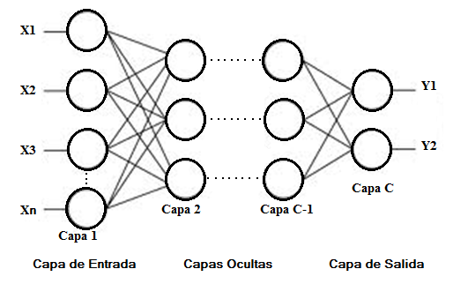

































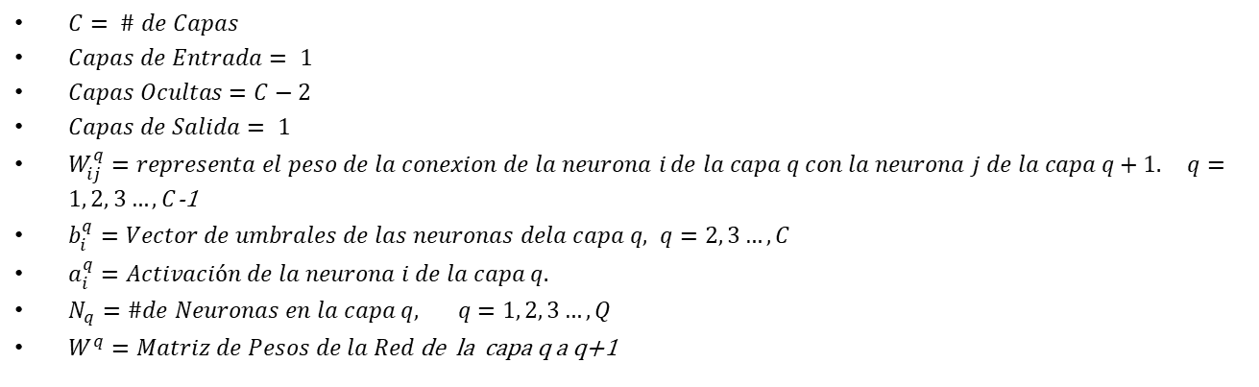
Perceptron Multicapa
$$b_{1}^{2}$$
$$X_{1}$$
$$w_{11}^{1}$$
$$a_{1}^{1}$$
$$a_{1}^{2}$$
$$w_{11}^{2}$$
$$b_{1}^{3}$$
$$w_{12}^{1}$$
$$w_{13}^{1}$$
$$w_{12}^{2}$$
$$a_{1}^{3}$$
$$Y_{1}$$
$$w_{21}^{1}$$
$$w_{21}^{2}$$
$$X_{2}$$
$$a_{2}^{1}$$
$$w_{22}^{1}$$
$$a_{2}^{2}$$
$$w_{22}^{2}$$
$$w_{23}^{1}$$
$$b_{2}^{2}$$
$$w_{31}^{2}$$
$$a_{2}^{3}$$
$$Y_{2}$$
$$w_{31}^{1}$$
$$w_{32}^{1}$$
$$w_{32}^{2}$$
$$b_{2}^{3}$$
$$X_{3}$$
$$a_{3}^{1}$$
$$a_{3}^{2}$$
$$w_{33}^{1}$$
$$b_{3}^{2}$$
$C= \# de Capas$
$Capas de Entrada= 1$
$Capas Ocultas=C−2$
$Capas de Salida= 1$
$W_{ij}^{q}=representa el peso de la conexion de la neurona i$ $de la capa q con la neurona j de la capa q+1. q=1, 2, 3…, C$-1
$b_{i}^{q}=Vector de umbrales de las neuronas dela capa q, q=2, 3…, C$
$a_{i}^{q}=Activación de la neurona i de la capa q.$
$N_{q}=\#de Neuronas en la capa q, q=1, 2, 3…, Q$
$W^{q}=Matriz de Pesos de la Red$ de la capa q a q+1

Slide 4





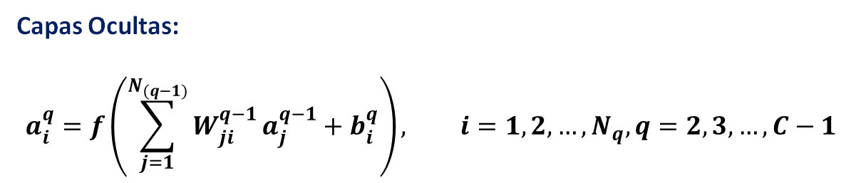


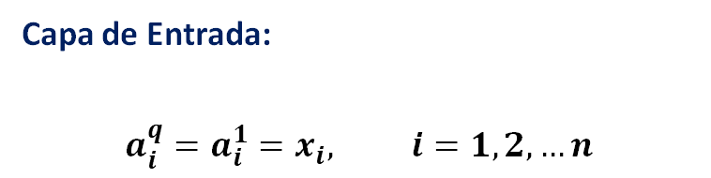



FORWARD
$$b_{1}^{2}$$
Activación de las Capas
$$X_{1}$$
$$w_{11}^{1}$$
$$a_{1}^{1}$$
$$a_{1}^{2}$$
$$w_{11}^{2}$$
$$b_{1}^{3}$$
$$w_{12}^{1}$$
Capa de Entrada:
$$a_{i}^{q}=a_{i}^{1}=x_{i}, i=1,2,…n$$
$$w_{13}^{1}$$
$$w_{12}^{2}$$
$$a_{1}^{3}$$
$$Y_{1}$$
$$w_{21}^{1}$$
$$w_{21}^{2}$$
$$X_{2}$$
$$a_{2}^{1}$$
$$w_{22}^{1}$$
$$a_{2}^{2}$$
$$w_{22}^{2}$$
$$w_{23}^{1}$$
$$b_{2}^{2}$$
$$w_{31}^{2}$$
$$a_{2}^{3}$$
$$Y_{2}$$
$$w_{31}^{1}$$
$$w_{32}^{1}$$
$$b_{2}^{3}$$
Capa de Salida:
$$a_{i}^{c}=y_{i}=f\left(\sum_{j=1}^{N_{(c−1)}}{W_{ji}^{c−1}}a_{j}^{c−1}+b_{i}^{c}\right), i=1,2, …,N_{c}$$
$$a_{3}^{2}$$
$$w_{32}^{2}$$
$$X_{3}$$
$$a_{3}^{1}$$
$$w_{33}^{1}$$
$$b_{3}^{2}$$
C
C-1
i
j
Capas Ocultas:
$$a_{i}^{q}=f\left(\sum_{j=1}^{N_{(q−1)}}{W_{ji}^{q−1}}a_{j}^{q−1}+b_{i}^{q}\right), i=1,2, …,N_{q}, q=2,3,…, C−1$$
$$a_{1 }^{3}=f(w_{11}^{2}∗a_{1}^{2}+ w_{21}^{2}∗a_{2}^{2}+w_{31}^{2}∗a_{3}^{2}+ b_{1}^{3})$$

Slide 5
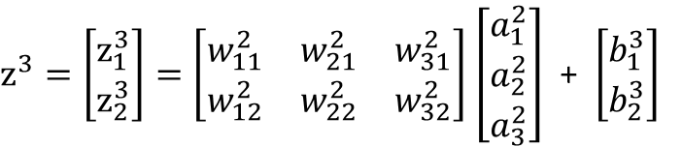
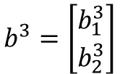






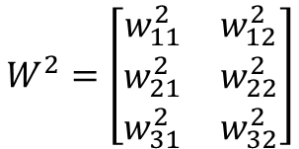







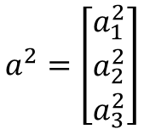




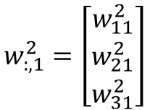













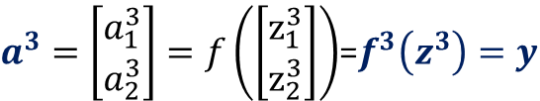


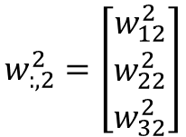





FORWARD
VECTORIZACIÓN
$$b_{1}^{2}$$
$$X_{1}$$
$$w_{11}^{1}$$
$$a_{1 }^{3}=f\left(z_{1 }^{3}\right)=f(w_{11}^{2}∗a_{1}^{2}+ w_{21}^{2}∗a_{2}^{2}+w_{31}^{2}∗a_{3}^{2}+ u_{1}^{3})$$
$$a_{1}^{1}$$
$$a_{1}^{2}$$
$$w_{11}^{2}$$
$$b_{1}^{3}$$
$$w_{12}^{1}$$
$$w_{13}^{1}$$
$$w_{12}^{2}$$
$$a_{1}^{3}$$
$$Y_{1}$$
$$w_{21}^{1}$$
$$w_{21}^{2}$$
$$X_{2}$$
$$a_{2}^{1}$$
$$w_{22}^{1}$$
$$a_{2}^{2}$$
$$w_{22}^{2}$$
$$a_{2 }^{3}=f\left(z_{2 }^{3}\right)=f(w_{12}^{2}∗a_{1}^{2}+ w_{22}^{2}∗a_{2}^{2}+w_{32}^{2}∗a_{3}^{2}+ u_{2}^{3})$$
$$w_{23}^{1}$$
$$b_{2}^{2}$$
$$w_{31}^{2}$$
$$a_{2}^{3}$$
$$Y_{2}$$
$$w_{31}^{1}$$
$$w_{32}^{1}$$
$$w_{32}^{2}$$
$$b_{2}^{3}$$
$z^{3}=\left[\begin{matrix}z_{1}^{3} \\ z_{2}^{3}\end{matrix}\right]=\left[\begin{matrix}\begin{matrix}w_{11}^{2} \\ w_{12}^{2}\end{matrix} & \begin{matrix}w_{21}^{2} \\ w_{22}^{2}\end{matrix} & \begin{matrix}w_{31}^{2} \\ w_{32}^{2}\end{matrix}\end{matrix}\right]$ $\left[\begin{matrix}a_{1}^{2} \\ a_{2}^{2} \\ a_{3}^{2}\end{matrix}\right]$ + $\left[\begin{matrix}b_{1}^{3} \\ b_{2}^{3}\end{matrix}\right]$
$$X_{3}$$
$$a_{3}^{1}$$
$$a_{3}^{2}$$
$$w_{33}^{1}$$
$$w_{:,1}^{2}=\left[\begin{matrix}w_{11}^{2} \\ w_{21}^{2} \\ w_{31}^{2}\end{matrix}\right]$$
$$b_{3}^{2}$$
$$a^{2}=\left[\begin{matrix}a_{1}^{2} \\ a_{2}^{2} \\ a_{3}^{2}\end{matrix}\right]$$
$2x$1
$$2x3$$
$2x$1
$N_{3}x$1
$3x$1
$$W^{2}=\left[\begin{matrix}\begin{matrix}w_{11}^{2} & w_{12}^{2}\end{matrix} \\ \begin{matrix}w_{21}^{2} & w_{22}^{2}\end{matrix} \\ \begin{matrix}w_{31}^{2} & w_{32}^{2}\end{matrix}\end{matrix}\right]$$
$${{z^{3}=W}^{2}}^{T}a^{2}+b^{3}$$
$3x$1
$$w_{:,2}^{2}=\left[\begin{matrix}w_{12}^{2} \\ w_{22}^{2} \\ w_{32}^{2}\end{matrix}\right]$$
$N_{2}x$1
$a^{3}=\left[\begin{matrix}a_{1}^{3} \\ a_{2}^{3}\end{matrix}\right]=f\left(\left[\begin{matrix}z_{1}^{3} \\ z_{2}^{3}\end{matrix}\right]\right)$=$f^{3}\left(z^{3}\right)=y$
$$3x2$$
$$b^{3}=\left[\begin{matrix}b_{1}^{3} \\ b_{2}^{3}\end{matrix}\right]$$
$$N_{2}xN_{3}$$
$2x$1
$N_{3}x$1

Slide 6







FORWARD
VECTORIZACIÓN
Capa 2
Capa 3
Capa l (cualquier Capa)
$${{z^{2}=W}^{1}}^{T}a^{1}+b^{2}$$
$${{z^{3}=W}^{2}}^{T}a^{2}+b^{3}$$
$${{z^{l}=W}^{l−1}}^{T}a^{l−1}+b^{l}$$
$$a^{2}=f^{2}(z^{2})$$
$$a^{3}=f^{3}(z^{3})$$
$$a^{l}=f^{l}(z^{l})$$
$$b_{1}^{2}$$
$$X_{1}$$
$$w_{11}^{1}$$
$$a_{1}^{1}$$
$$a_{1}^{2}$$
$$w_{11}^{2}$$
$$b_{1}^{3}$$
$$w_{12}^{1}$$
$$w_{13}^{1}$$
$$w_{12}^{2}$$
$$a_{1}^{3}$$
$$Y_{1}$$
$$w_{21}^{1}$$
$$w_{21}^{2}$$
$$X_{2}$$
$$a_{2}^{1}$$
$$w_{22}^{1}$$
$$a_{2}^{2}$$
$$w_{22}^{2}$$
$$w_{23}^{1}$$
$$b_{2}^{2}$$
$$w_{31}^{2}$$
$$a_{2}^{3}$$
$$Y_{2}$$
$$w_{31}^{1}$$
$$w_{32}^{1}$$
$$w_{32}^{2}$$
$$b_{2}^{3}$$
$$X_{3}$$
$$a_{3}^{1}$$
$$a_{3}^{2}$$
$$w_{33}^{1}$$
$$b_{3}^{2}$$

Slide 7
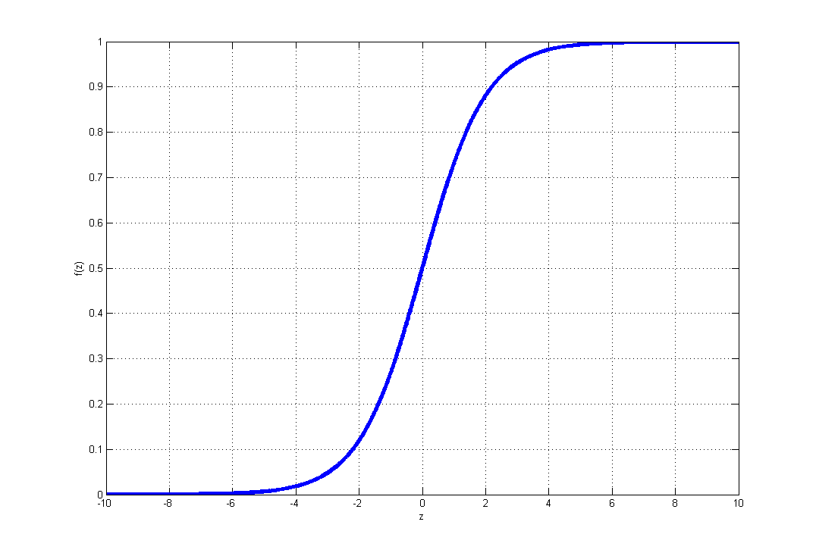
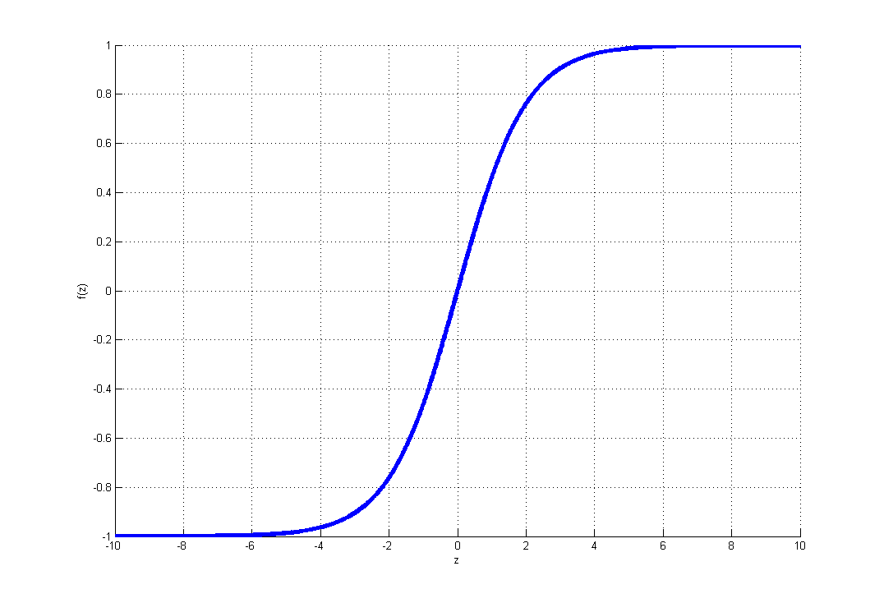

Funciones de Activación
Función Sigmoidal:
$f\left(z\right)= \frac{1}{1+e^{−z}}$
Función Tangente Hiperbólica:
$f\left(z\right)= \frac{1− e^{−z}}{1+e^{−z}}$

Slide 8
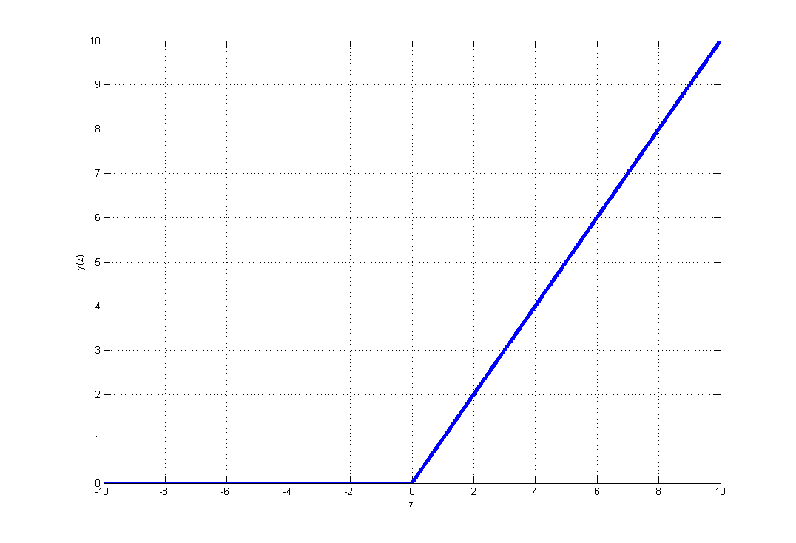
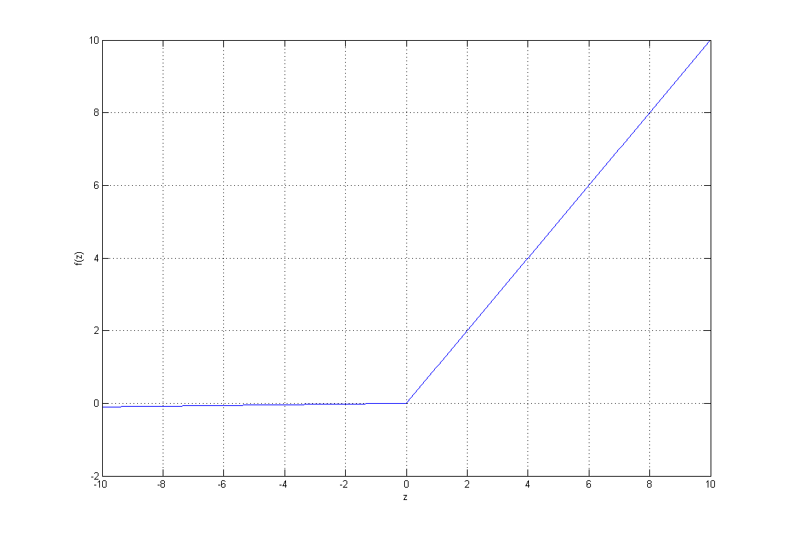

Funciones de Activación
Función RELU:
$f\left(z\right)=max⁡(0,z)$
Función Leaky Relu:
$f\left(z\right)=max⁡(0.01z,z)$

Slide 9
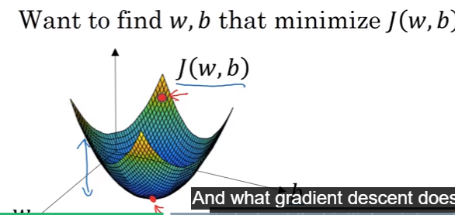

Funciones de Error
Median Squared Error
$$ℒ\left(S,Y\right)=e(n)=\frac{1}{2}{(S−Y) }^{2}$$
$S(n):$ Salidas deseadas de la red para el patrón $n$
Y$(n):$ Vector de salida de la red para el patrón $n$
Logistic Regression Loss Function
$$ℒ\left(S,Y\right)=e\left(n\right)=−(S\log{Y+}(1−S)\log{(1−Y))}$$
Cost Function
$$J\left(w,b\right)=E=\frac{1}{N}\sum_{n=1}^{N}{ℒ\left(S,Y\right)=\frac{1}{N}\sum_{n=1}^{N}{e(n)}}$$

Slide 10
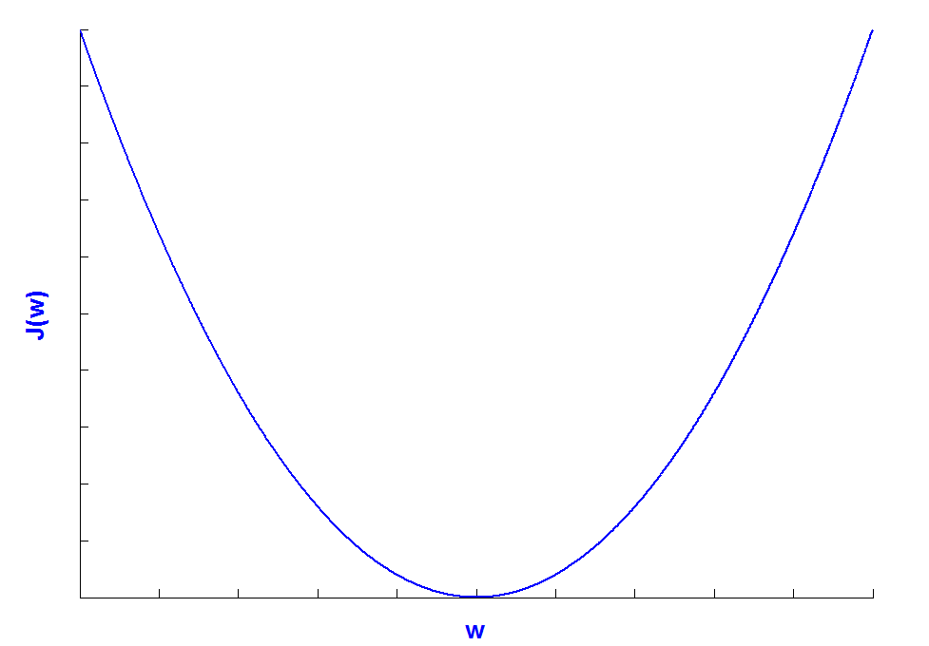

Descenso del Gradiente
Método del Descenso del Gradiente Estocástico
$w\left(n\right)=w\left(n−1\right)− α\frac{∂e(n)}{∂w}$, $α$: factor de aprendizaje
Método del Descenso del Gradiente
$w\left(n\right)=w\left(n−1\right)− α\frac{∂J(w,b)}{∂w}$,

Slide 11

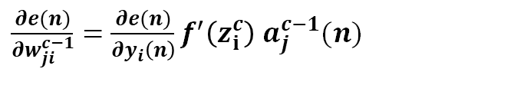

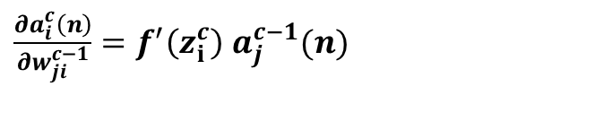
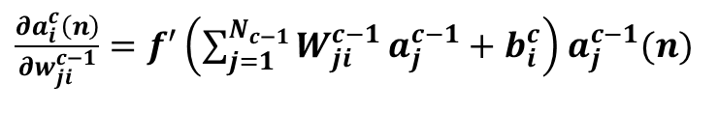
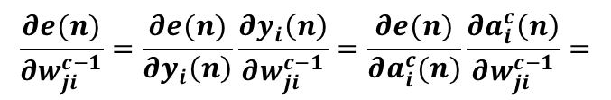
BACKPROPAGATION
Como se modifican los Pesos a la Capa de Salida y Umbrales de la capa de salida
$w_{ji}^{c−1}\left(n\right)=w_{ji}^{c−1}\left(n−1\right)− α\frac{∂e(n)}{∂w_{ji}^{c−1}}$
$$a_{i}^{c}=y_{i}=f\left(z_{i}^{c}\right)=f\left(\sum_{j=1}^{N_{(c−1)}}{W_{ji}^{c−1}}a_{j}^{c−1}+b_{i}^{c}\right)$$
$$\frac{∂e(n)}{∂w_{ji}^{c−1}}=\frac{∂e(n)}{∂y_{i}\left(n\right)}\frac{∂y_{i}\left(n\right)}{∂w_{ji}^{c−1}}=\frac{∂e(n)}{∂a_{i}^{c}(n)}\frac{∂a_{i}^{c}\left(n\right)}{∂w_{ji}^{c−1}}=$$
¡Recordemos!
$\frac{∂a_{i}^{c}\left(n\right)}{∂w_{ji}^{c−1}}=f^{′}\left(\sum_{j=1}^{N_{c−1}}{W_{ji}^{c−1}}a_{j}^{c−1}+b_{i}^{c}\right)$ $a_{j}^{c−1}(n)$
$\frac{∂a_{i}^{c}\left(n\right)}{∂w_{ji}^{c−1}}=f^{′}\left(z_{i}^{c}\right)$ $a_{j}^{c−1}(n)$
$\frac{∂e(n)}{∂w_{ji}^{c−1}}=\frac{∂e(n)}{∂y_{i}\left(n\right)}f^{′}\left(z_{i}^{c}\right)$ $a_{j}^{c−1}(n)$

Slide 12
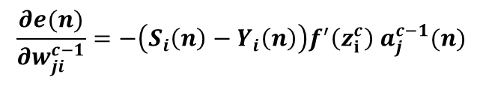

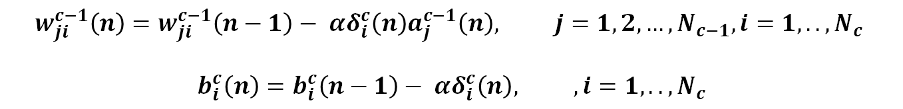
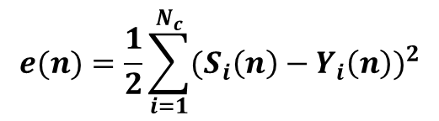
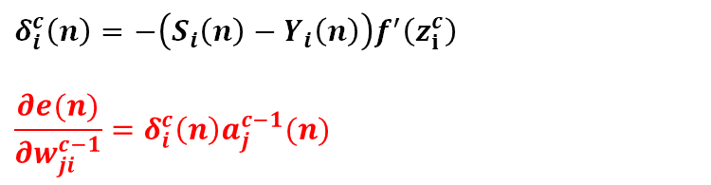
BACKPROPAGATION
Como se modifican los Pesos a la Capa de Salida y Umbrales de la capa de salida
Con Error Cuadrático Medio como función de error
Error Cuadrático Medio
$$e(n)=\frac{1}{2}\sum_{i=1}^{N_{c}}{{(S_{i}\left(n\right)−Y_{i}\left(n\right))}^{2}}$$
$$\frac{∂e(n)}{∂w_{ji}^{c−1}}=−\left(S_{i}\left(n\right)−Y_{i}\left(n\right)\right)f^{′}\left(z_{i}^{c}\right) a_{j}^{c−1}(n)$$
$$δ_{i}^{c}\left(n\right)=−\left(S_{i}\left(n\right)−Y_{i}\left(n\right)\right)f^{′}\left(z_{i}^{c}\right)$$
$$\frac{∂e(n)}{∂w_{ji}^{c−1}}=δ_{i}^{c}\left(n\right)a_{j}^{c−1}(n)$$
Término que contiene el error cometido por la red para la neurona i de la capa c
$$\frac{∂e(n)}{∂z_{i}^{c}}=δ_{i}^{c}\left(n\right)$$
$$w_{ji}^{c−1}\left(n\right)=w_{ji}^{c−1}\left(n−1\right)− αδ_{i}^{c}\left(n\right)a_{j}^{c−1}\left(n\right), j=1,2, …,N_{c−1}, i=1,.., N_{c}$$
$$b_{i}^{c}\left(n\right)=b_{i}^{c}\left(n−1\right)− αδ_{i}^{c}\left(n\right), , i=1,.., N_{c}$$

Slide 13




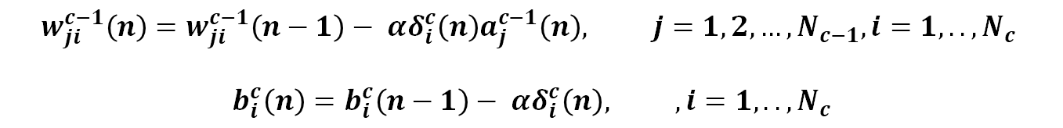




BACKPROPAGATION
Como se modifican los Pesos a la Capa de Salida y Umbrales de la capa de salida
Con Error Cuadrático Medio como función de error
$$w_{ji}^{c−1}\left(n\right)=w_{ji}^{c−1}\left(n−1\right)− αδ_{i}^{c}\left(n\right)a_{j}^{c−1}\left(n\right), j=1,2, …,N_{c−1}, i=1,.., N_{c}$$
$$b_{i}^{c}\left(n\right)=b_{i}^{c}\left(n−1\right)− αδ_{i}^{c}\left(n\right), , i=1,.., N_{c}$$
$$\frac{∂e(n)}{∂z_{i}^{c}}=δ_{i}^{c}\left(n\right)$$
$$z_{j}^{c−1}$$
$$a_{j}^{c−1}$$
$$w_{ji}^{c−1}$$
$$z_{i}^{c}$$
$$a_{i}^{c}$$
$$Capa c−1$$
$Capa$c

Slide 14




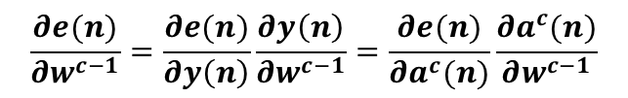
BACKPROPAGATION
VECTORIZACIÓN
Como se modifican los Pesos a la Capa de Salida y Umbrales de la capa de salida
$w^{c−1}\left(n\right)=w^{c−1}\left(n−1\right)− α\frac{∂e(n)}{∂w^{c−1}}$
$a^{c}\left(n\right)=y\left(n\right)=f\left(z^{c}\right)$
$$\frac{∂e(n)}{∂w^{c−1}}=\frac{∂e(n)}{∂y\left(n\right)}\frac{∂y\left(n\right)}{∂w^{c−1}}=\frac{∂e(n)}{∂a^{c}(n)}\frac{∂a^{c}(n)}{∂w^{c−1}}$$
$${{z^{c}=W}^{c−1}}^{T}a^{c−1}+b^{c}$$
$$\frac{∂a^{c}(n)}{∂w^{c−1}}=f^{′}\left(z^{c}\right)a^{c−1}$$
$$\frac{∂e(n)}{∂w^{c−1}}=\frac{∂e(n)}{∂a^{c}(n)}f^{′}\left(z^{c}\right)a^{c−1}$$

Slide 15

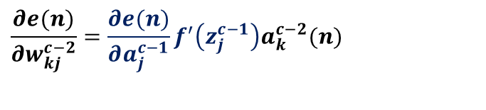
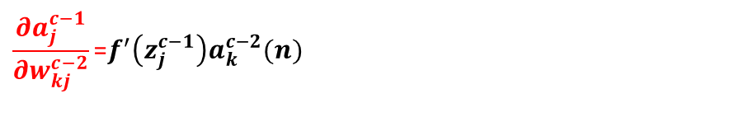
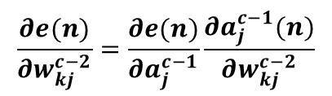
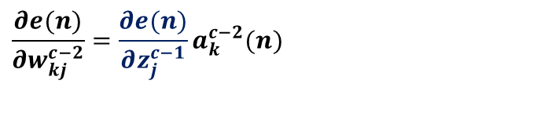
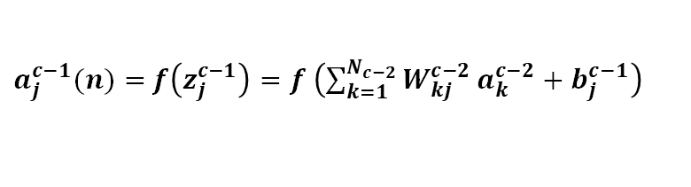
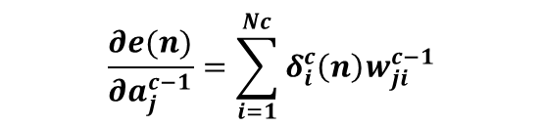
BACKPROPAGATION
Modificación de los pesos de Otras Capas (C-2)->(C-1).
$$w_{kj}^{c−2}\left(n\right)=w_{kj}^{c−2}\left(n−1\right)− α\frac{∂e(n)}{∂w_{kj}^{c−2}}$$
$$\frac{∂e(n)}{∂w_{kj}^{c−2}}=\frac{∂e(n)}{∂a_{j}^{c−1}}\frac{∂a_{j}^{c−1}(n)}{∂w_{kj}^{c−2}}$$
$a_{j}^{c−1}(n)=$ $f\left(z_{j}^{c−1}\right)=f \left(\sum_{k=1}^{N_{c−2}}{W_{kj}^{c−2}}a_{k}^{c−2}+b_{j}^{c−1}\right)$
$$\frac{∂a_{j}^{c−1}}{∂w_{kj}^{c−2}}\text{=}f^{′}\left(z_{j}^{c−1}\right)a_{k}^{c−2}(n)$$
$$\frac{∂e(n)}{∂w_{kj}^{c−2}}=\frac{∂e(n)}{∂a_{j}^{c−1}}f^{′}\left(z_{j}^{c−1}\right)a_{k}^{c−2}(n)$$
$$\frac{∂e(n)}{∂w_{kj}^{c−2}}=\frac{∂e(n)}{∂z_{j}^{c−1}}a_{k}^{c−2}(n)$$
Con Error Cuadrático Medio como función de error
$$\frac{∂e(n)}{∂a_{j}^{c−1}}=−\sum_{i=1}^{Nc}{\left(S_{i}\left(n\right)−Y_{i}\left(n\right)\right)\frac{∂y_{i}\left(n\right)}{∂a_{j}^{c−1}}}=−\sum_{i=1}^{Nc}{\left(S_{i}\left(n\right)−Y_{i}\left(n\right)\right)}f^{′}\left(z_{i}^{c}\right)w_{ji}^{c−1}(n)$$
$$\frac{∂e(n)}{∂a_{j}^{c−1}}=\sum_{i=1}^{Nc}{δ_{i}^{c}\left(n\right)w_{ji}^{c−1}}$$

Slide 16
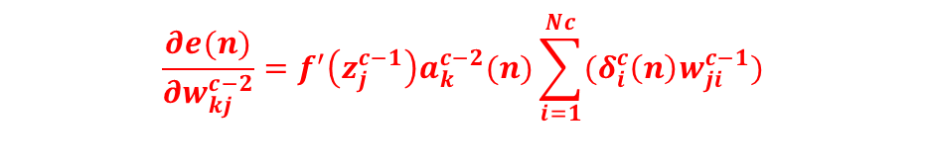
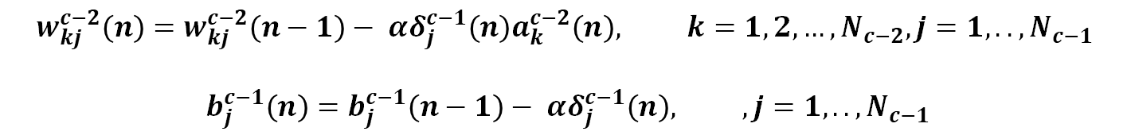
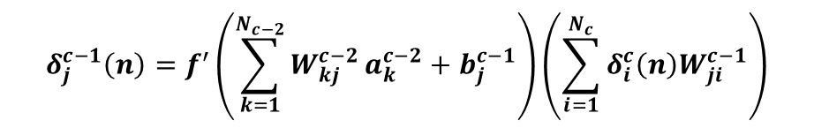
BACKPROPAGATION
Modificación de los pesos de Otras Capas (C-2)->(C-1).
Con Error Cuadrático Medio como función de error
$$\frac{∂e(n)}{∂w_{kj}^{c−2}}=f^{′}\left(z_{j}^{c−1}\right)a_{k}^{c−2}(n)\sum_{i=1}^{Nc}{(δ_{i}^{c}\left(n\right)w_{ji}^{c−1})}$$
$$δ_{j}^{c−1}\left(n\right)=f^{′}\left(\sum_{k=1}^{N_{c−2}}{W_{kj}^{c−2}}a_{k}^{c−2}+b_{j}^{c−1}\right)\left(\sum_{i=1}^{N_{c}}{{δ_{i}^{c}\left(n\right)W}_{ji}^{c−1}}\right)$$
Término que contiene el error cometido por la red para la neurona j de la capa c-1
$$w_{kj}^{c−2}\left(n\right)=w_{kj}^{c−2}\left(n−1\right)− αδ_{j}^{c−1}\left(n\right)a_{k}^{c−2}\left(n\right), k=1,2, …,N_{c−2}, j=1,.., N_{c−1}$$
$$b_{j}^{c−1}\left(n\right)=b_{j}^{c−1}\left(n−1\right)− αδ_{j}^{c−1}\left(n\right), , j=1,.., N_{c−1}$$

Slide 17












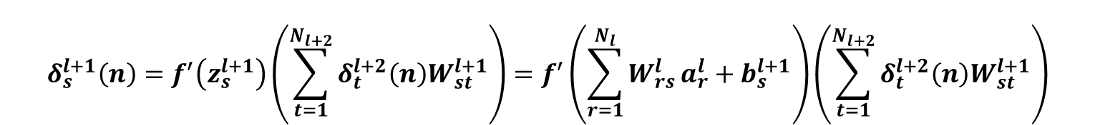
BACKPROPAGATION
Generalizando para cualquier capa
$$w_{rs}^{l}\left(n\right)=w_{rs}^{l}\left(n−1\right)− αδ_{s}^{l+1}\left(n\right)a_{r}^{l}\left(n\right)$$
$$δ_{s}^{l+1}\left(n\right)=f^{′}\left(z_{s}^{l+1}\right)\left(\sum_{t=1}^{N_{l+2}}{{δ_{t}^{l+2}\left(n\right)W}_{st}^{l+1}}\right)=f^{′}\left(\sum_{r=1}^{N_{l}}{W_{rs}^{l}}a_{r}^{l}+b_{s}^{l+1}\right)\left(\sum_{t=1}^{N_{l+2}}{{δ_{t}^{l+2}\left(n\right)W}_{st}^{l+1}}\right)$$
$$b_{s}^{l+1}\left(n\right)=b_{s}^{l+1}\left(n−1\right)− αδ_{s}^{l+1}\left(n\right) s=1,2, …,N_{l+1},$$
$$δ_{s}^{l+1}$$
$$z_{r}^{l}$$
$$a_{r}^{l}$$
$$w_{rs}^{l}$$
$$z_{s}^{l+1}$$
$$a_{s}^{l+1}$$
$$w_{st}^{l+1}$$
$$\sum_{t=1}^{N_{l+2}}{δ_{t}^{l+2}}$$
$$Capa l$$
$$Capa l+1$$
$$b_{s}^{l+1}$$

Slide 18






































BACKPROPAGATION
Generalizando para cualquier capa
$$b_{1}^{2}$$
$$δ_{1}^{2}$$
$$X_{1}$$
$$w_{11}^{1}$$
$$a_{1}^{1}$$
$$a_{1}^{2}$$
$$w_{11}^{2}$$
$$b_{1}^{3}$$
$$w_{12}^{1}$$
$$δ_{1}^{3}$$
$$w_{13}^{1}$$
$$w_{12}^{2}$$
$$a_{1}^{3}$$
$$Y_{1}$$
$$δ_{2}^{2}$$
$$w_{21}^{1}$$
$$w_{21}^{2}$$
$$X_{2}$$
$$a_{2}^{1}$$
$$w_{22}^{1}$$
$$a_{2}^{2}$$
$$w_{22}^{2}$$
$$w_{23}^{1}$$
$$b_{2}^{2}$$
$$w_{31}^{2}$$
$$a_{2}^{3}$$
$$Y_{2}$$
$$w_{31}^{1}$$
$$w_{32}^{1}$$
$$δ_{2}^{3}$$
$$w_{32}^{2}$$
$$b_{2}^{3}$$
$$X_{3}$$
$$a_{3}^{1}$$
$$a_{3}^{2}$$
$$w_{33}^{1}$$
$$δ_{3}^{2}$$
$$b_{3}^{2}$$

Slide 19


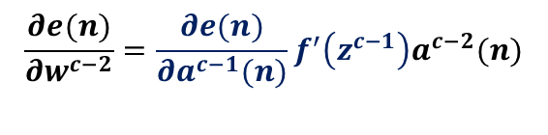





BACKPROPAGATION
VECTORIZACIÓN
Modificación de los pesos de Otras Capas (C-2)->(C-1).
$$w^{c−2}\left(n\right)=w^{c−2}\left(n−1\right)− α\frac{∂e(n)}{∂w^{c−2}}$$
$$\frac{∂e(n)}{∂w^{c−2}}=\frac{∂e(n)}{∂a^{c−1}(n)}\frac{∂a^{c−1}(n)}{∂w^{c−2}}$$
$$a^{c−1}\left(n\right)=f\left(z^{c−1}\right)$$
$$\frac{∂a^{c−1}(n)}{∂w^{c−2}}=f^{′}\left(z^{c−1}\right)a^{c−2}(n)$$
$$z^{c−1}\left(n\right)={W^{c−2}}^{T}a^{c−2}+b^{c−1}$$
$$\frac{∂e(n)}{∂w^{c−2}}=\frac{∂e(n)}{∂a^{c−1}(n)}f^{′}\left(z^{c−1}\right)a^{c−2}(n)$$
$$\frac{∂e(n)}{∂a^{c−1}(n)}=\frac{∂e(n)}{∂a^{c}(n)}\frac{∂a^{c}(n)}{∂z^{c}(n)}\frac{∂z^{c}(n)}{∂a^{c−1}(n)}$$
$$\frac{∂e(n)}{∂w^{c−2}}=\frac{∂e(n)}{∂z^{c−1}(n)}a^{c−2}(n)$$

Slide 20







BACKPROPAGATION
VECTORIZACIÓN
Generalizando para cualquier capa
$$w^{l}\left(n\right)=w^{l}\left(n−1\right)− α\frac{∂e(n)}{∂w^{l}}$$
$$\frac{∂e(n)}{∂w^{l}}=\frac{∂e(n)}{∂a^{l+1}(n)}\frac{∂a^{l+1}(n)}{∂w^{l}}$$
$$z^{l+1}\left(n\right)={W^{l}}^{T}a^{l}+b^{l+1}$$
$$\frac{∂a^{l+1}(n)}{∂w^{l}}=f^{′}\left(z^{l+1}\right)a^{l}(n)$$
$$a^{l+1}\left(n\right)=f\left(z^{l+1}\right)$$
$$\frac{∂e(n)}{∂w^{l}}=\frac{∂e(n)}{∂a^{l+1}(n)}f^{′}\left(z^{l+1}\right)a^{l}(n)$$
$$\frac{∂e(n)}{∂a^{l+1}(n)}=\frac{∂e(n)}{∂a^{l+2}(n)}\frac{∂a^{l+2}(n)}{∂z^{l+2}(n)}\frac{∂z^{l+2}(n)}{∂a^{l+1}(n)}$$

Slide 21































FORWARD
Capa 1
Capa 2
Capa l
Capa C
$$b_{1}^{2}$$
$$b_{1}^{l}$$
$$X_{1}$$
$$w_{11}^{1}$$
$$a_{1}^{1}$$
$$a_{1}^{2}$$
$$a_{2}^{l}$$
$$b_{1}^{c}$$
$$w_{12}^{1}$$
$$w_{13}^{1}$$
$$a_{1}^{c}$$
$$Y_{1}$$
$$w_{21}^{1}$$
$$X_{2}$$
$$a_{2}^{1}$$
$$w_{22}^{1}$$
$$a_{2}^{2}$$
$$a_{2}^{l}$$
$$w_{23}^{1}$$
$$a_{2}^{c}$$
$$Y_{2}$$
$$b_{2}^{2}$$
$$b_{2}^{l}$$
$$w_{31}^{1}$$
$$w_{32}^{1}$$
$$b_{2}^{c}$$
$$X_{3}$$
$$a_{3}^{2}$$
$$a_{3}^{l}$$
$$a_{3}^{1}$$
$$w_{33}^{1}$$
$$b_{3}^{2}$$
$$b_{3}^{l}$$

Slide 22




































FORWARD-BACKWARD
$$a^{2}$$
$$w^{l−1}$$
$$,b^{l}$$
$$a^{l}=a^{c−1}$$
$$a^{c}=Y$$
$$X{=a}^{1}$$
$$z^{2}$$
$$a^{3}$$
$$a^{l−1}$$
$$z^{l}$$
$$w^{l},b^{c}$$
$$z^{c}$$
$$w^{1},b^{2}$$
$$w^{2},b^{3}$$
$$z^{3}$$
$${{z^{l}=W}^{l−1}}^{T}a^{l−1}+b^{l}$$
$$a^{1},z^{2}$$
$$a^{2},z^{3}$$
$$a^{l−1},z^{l}$$
$$a^{c−1},z^{c}$$
$$a^{l}=f^{l}(z^{l})$$
$$\frac{∂e}{∂a^{2}}$$
$$\frac{∂e}{∂a^{3}}$$
$$\frac{∂e}{∂a^{l−1}}$$
$$\frac{∂e}{∂a^{c−1}}$$
$$\frac{∂e}{∂a^{c}}$$
$$f^{′}\left(z^{2}\right)$$
$$f^{′}\left(z^{3}\right)$$
$$f^{′}\left(z^{c−1}\right)$$
$$f^{′}\left(z^{c}\right)$$
$$\frac{∂e(n)}{∂w^{1}},\frac{∂e(n)}{∂b^{2}}$$
$$\frac{∂e(n)}{∂w^{2}},\frac{∂e(n)}{∂b^{3}}$$
$$\frac{∂e(n)}{∂w^{c−2}},\frac{∂e(n)}{∂b^{c−1}}$$
$$\frac{∂e(n)}{∂w^{c−1}},\frac{∂e(n)}{∂b^{c}}$$
$$w^{c−1}\left(n\right)=w^{c−1}\left(n−1\right)− α\frac{∂e(n)}{∂w^{c−1}}$$
$$\frac{∂e(n)}{∂w^{l}}=\frac{∂e(n)}{∂a^{l+1}(n)}f^{′}\left(z^{l+1}\right)a^{l}(n)$$
$$b_{i}^{c}\left(n\right)=b_{i}^{c}\left(n−1\right)− αδ_{i}^{c}\left(n\right),$$

